Slide 1

ApniNewz – College News Blog Platform
A centralized digital platform for college-related news and updates.
Developed by Aryan Panchal, Umang Patel, Kalp Shah.
Enrollment Numbers: 205170686026, 205190686051, 205170686017.
Guided by Prof. Khushali Vala at L.J. Institute of Computer Application.
Group No: MCA_10_G30 | Presentation Date: April 2025

Slide 2
INTRODUCTION
ApniNewz is a dynamic web application developed using Django and Python to streamline communication within college communities.
It allows students to access academic and event updates, creating a centralized source of truth for all institutional information.
This platform reduces the dependence on outdated methods like notice boards and unorganized WhatsApp groups.
Features like account creation, news posting, rich text formatting, and commenting enhance user interactivity and engagement.

Slide 3
PROBLEM STATEMENT
Most colleges use notice boards, emails, and informal chat groups for news updates, which are inefficient and often lead to missed information.
These traditional methods result in delays, fragmented communication, and low student involvement.
The lack of a unified and interactive system makes it difficult for students to stay informed in real-time.
A need exists for a modern digital platform tailored specifically to a college's internal communication ecosystem.

Slide 4
OBJECTIVES
To provide a centralized and efficient platform for managing all college-related announcements and news.
Ensure faster, more reliable dissemination of updates to the student and faculty community.
Improve student involvement by allowing them to contribute, react, and comment on posts.
Make the platform accessible on mobile and desktop, ensuring all users can stay connected at all times.

Slide 5
CORE FEATURES
Authentication: A secure system for user registration, login, and password reset to manage access and personalization.
Post Management: Allows users to create, edit, delete, and categorize posts to maintain organized content flow.
Commenting: Enables discussion by allowing users to leave comments and respond to others, promoting collaboration.
Likes/Unlikes: Simple interaction tools that let users express appreciation or feedback on news posts.

Slide 6
CORE FEATURES
Profile: Each user has a customizable profile with pictures, bio, and optional social media links.
Responsive UI: Built using Bootstrap, the site is mobile-friendly and functions seamlessly on all screen sizes.
Image & Rich Text Support: CKEditor integration enables formatting and media embedding within posts.

Slide 7
TECHNOLOGY STACK
Frontend: HTML, CSS, and Bootstrap ensure a structured and responsive user interface.
Backend: Django framework in Python handles business logic, routing, and authentication securely.

Slide 8
TECHNOLOGY STACK
Database: Django ORM manages database interactions, with SQLite used for development and PostgreSQL for production.
Tools: Development was carried out using VS Code, GitHub for version control, and Django Admin for backend management.
Libraries: CKEditor was used for rich text editing; potential for Django REST integration for future API support.

Slide 9
SYSTEM DESIGN
Use Case Diagram: Highlights how different user roles interact with the system's features and processes.
Class Diagram: Displays the relationships and structure of main entities like User, News Post, Category, Comment, and Profile.
Activity Diagram: Describes the workflows such as user login, news publishing, and interacting with posts.

Slide 10
SYSTEM DESIGN
Interaction Diagram: Showcases the step-by-step interactions between the User, Website System, and Database during activities like logging in, posting, and commenting.
Data Dictionary: Defines the database schema, listing all fields and constraints for every major model.

Slide 11
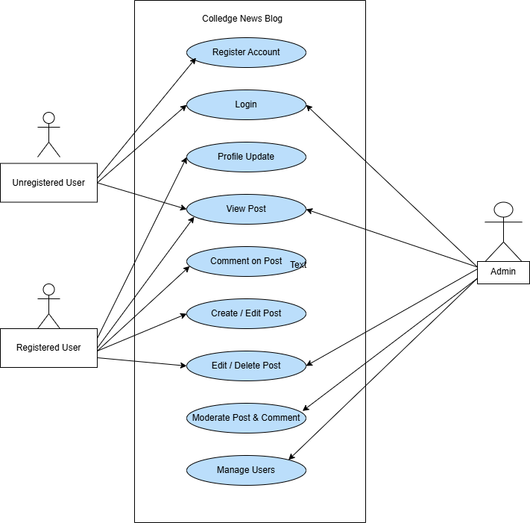
Use Case Diagram: Highlights how different user roles interact with the system's features and processes.

Slide 12
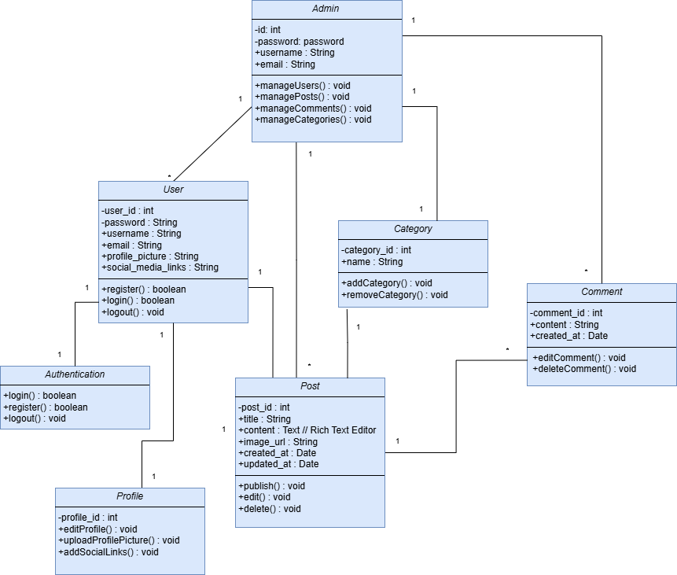
Class Diagram: Displays the relationships and structure of main entities like User, News Post, Category, Comment, and Profile.

Slide 13
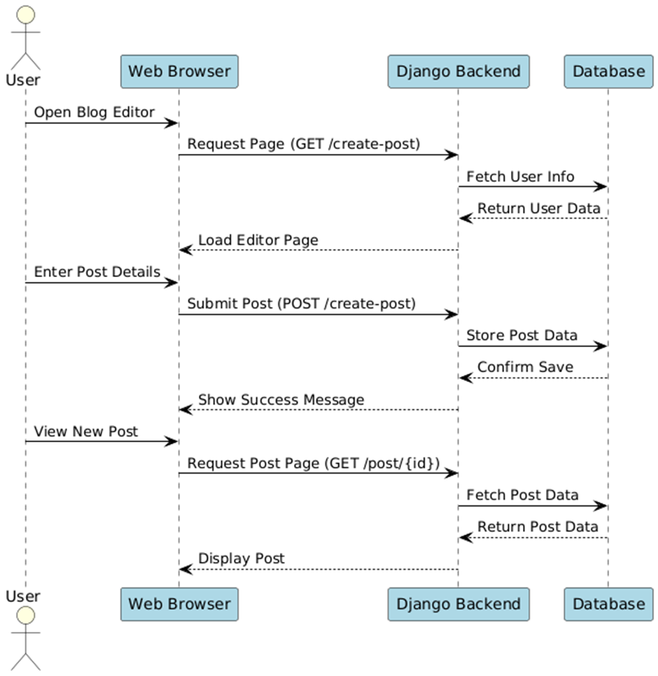
Interaction Diagram: Showcases the step-by-step interactions between the User, Website System, and Database during activities like logging in, posting, and commenting.

Slide 14
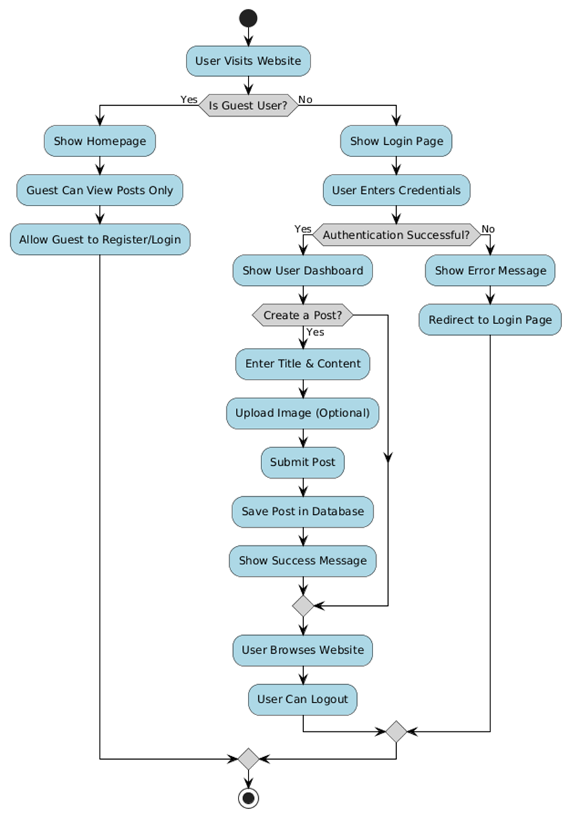
Activity Diagram: Describes the workflows such as user login, news publishing, and interacting with posts.

Slide 15
DEVELOPMENT PROCESS
The development process followed Agile methodology, ensuring incremental delivery and adaptability to feedback.
The project spanned 3 months from January to April 2025, divided into 11 sprints for better planning and execution.
Initial sprints focused on setup, UI design, and authentication, while later sprints introduced commenting, responsiveness, and deployment.
Each sprint was completed with planning, execution, testing, and review, ensuring quality and consistency throughout.

Slide 16
TESTING HIGHLIGHTS
Comprehensive manual testing was carried out to ensure the reliability of major modules.
Login Module: Successfully tested for valid, invalid, and edge-case credential inputs.
Registration: Checked for email uniqueness, password matching, and required field validation.

Slide 17
TESTING HIGHLIGHTS
Comment System: Verified for comment creation, edit/delete functionality, and error handling.
Payment (Optional): Included checkout and card validation; tested both success and failure cases.
Overall, the system passed most tests with minor issues resolved promptly during development.

Slide 18
PROPOSED ENHANCEMENTS
Introduction of multilingual capabilities to make the platform more inclusive for diverse users.
Implementation of a powerful search system with filters by tags, categories, and authors.
Expanded user roles to include content editors, moderators, and department-specific admins.

Slide 19
PROPOSED ENHANCEMENTS
Real-time notifications to alert users about new posts, comments, or likes.
Admin analytics dashboard to track user activity, popular posts, and platform usage metrics.
Integration of a college calendar for events, and support for uploading video content.
Development of an API layer to connect with external tools or mobile applications.

Slide 20
Conclusion
ApniNewz successfully bridges the gap in campus communication by providing a feature-rich and user-friendly web platform.
It fulfills its goal of enhancing student-faculty interaction and offering a structured place for news sharing.
With strong foundational features and an Agile-based development model, it is scalable for future use and innovation.
The project also served as an excellent opportunity to apply and expand full-stack development skills using Django.

Slide 21
REFERENCES
Books:
"Django for Beginners" by William Vincent
"Python Crash Course" by Eric Matthes
"Clean Code" by Robert C. Martin
Online:
Codemy YouTube (https://www.youtube.com/c/Codemycom)
Django Docs (https://docs.djangoproject.com)
Bootstrap Docs (https://getbootstrap.com)
GitHub (https://github.com)

